Slide 1
Designing for Web
COURSE ABSTRACT

Slide 2
TRAINING
OUTLINE
Introduction
Section 1 - Basic Web Concepts
Section 2 - Page Components
Section 3 - Technological Dependencies
Section 4 - Optimizing the deliverable
Section 5 - Web Design Exercise

Slide 3
BASIC WEB CONCEPTS
What is a website, intranet and web application
Understanding the Key Elements
Websites
Intranets
Web Applications
Mobile Apps
Technology driven sites

Slide 4
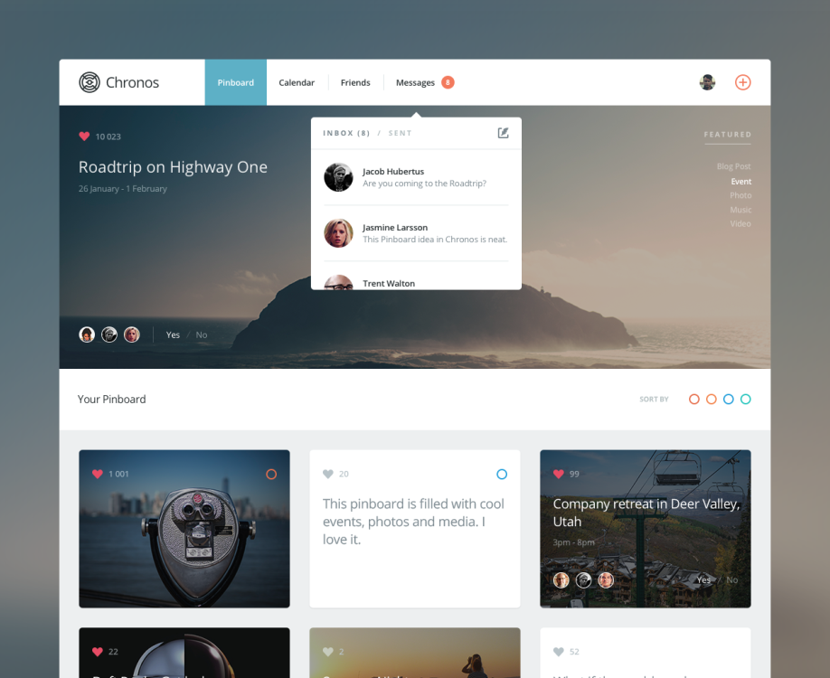
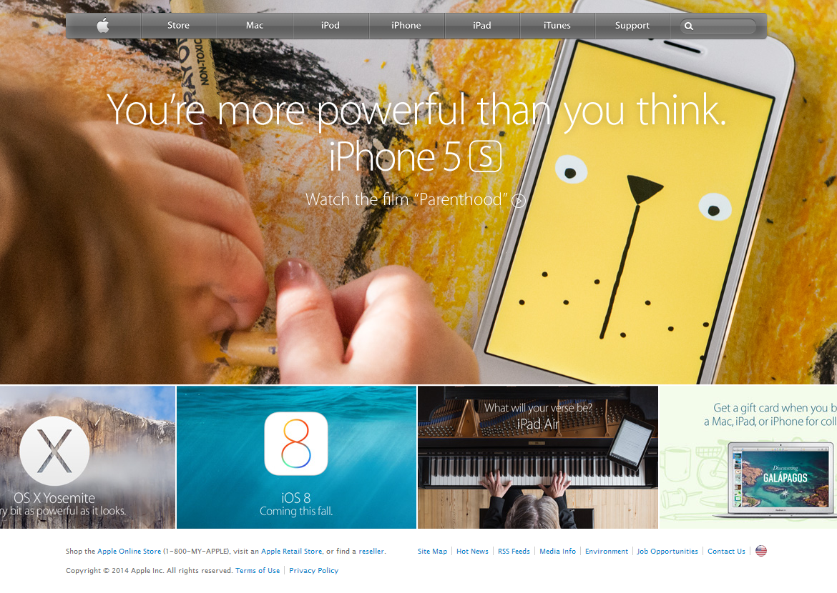
What is a website, intranet and web application?
Website
A collection of web pages, images, scripts, videos and multimedia files, hosted on one or multiple servers visible on the Internet is called a website.
Static Website A website primarily used to provide information is considered to be a static site.
Dynamic Website A dynamic uses a backend database to fetch information from the web servers to display information based on user input. This provides option for two communication..

Slide 5
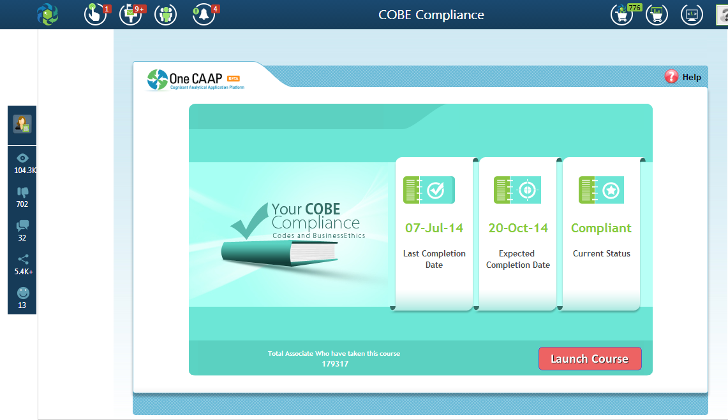
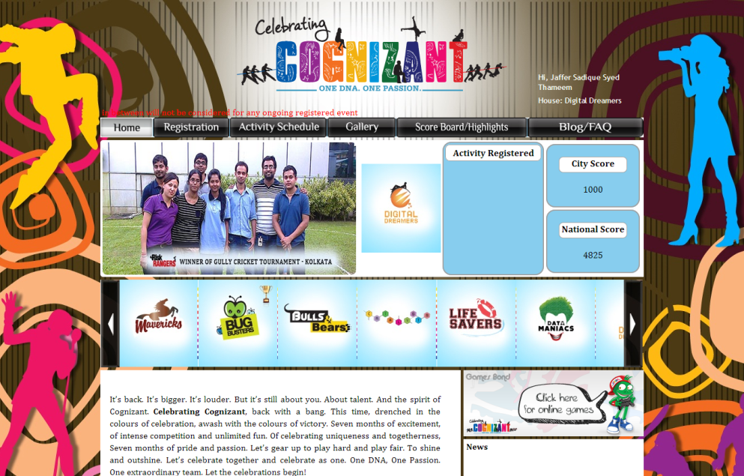
What is a website, intranet and web application?
Intranet
Uses network technologies as a tool to facilitate communication between people or workgroups to improve the data sharing capability and overall knowledge base of an organization's employees.
Generally the intranet portal is hidden from public view and is password restricted so that only the intended users have access to it.

Slide 6
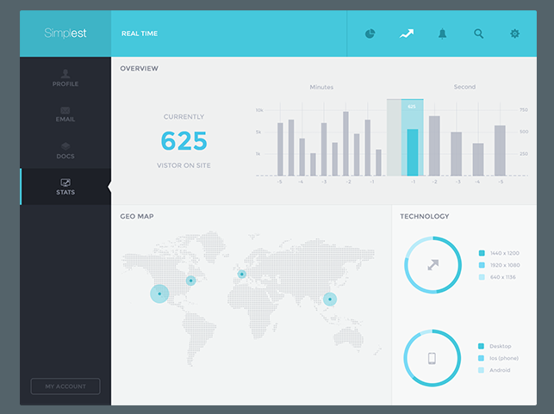
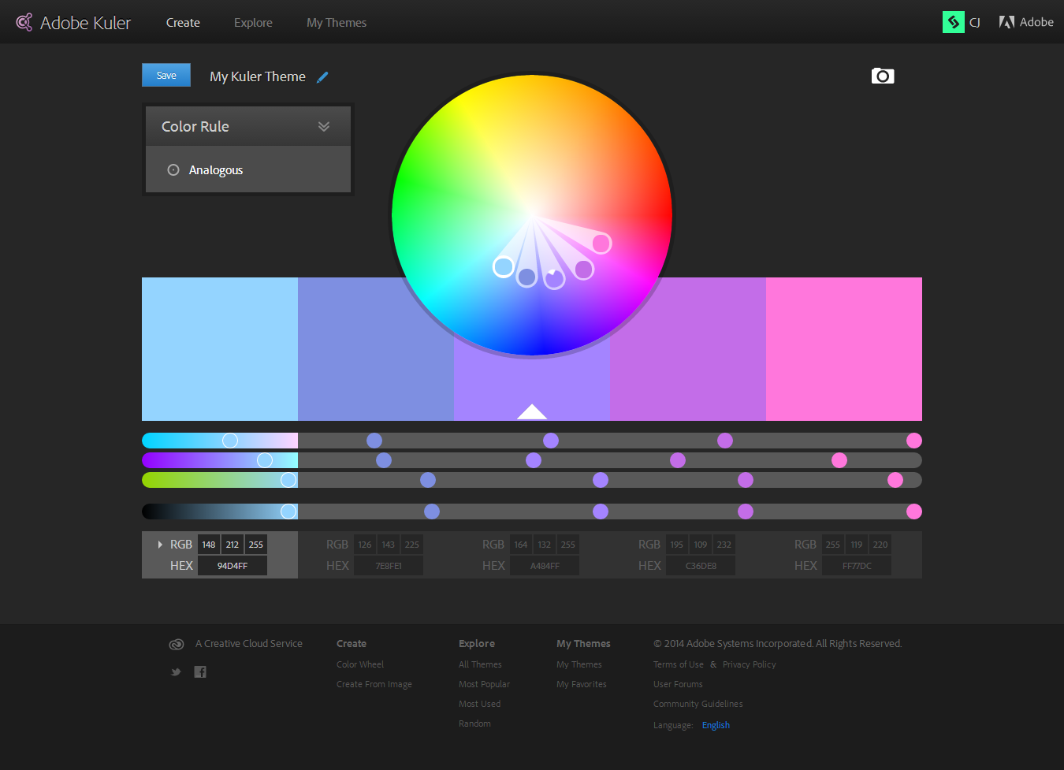
What is a website, intranet and web application?
Web Apps
A computer software application that is coded in a browser-supported language (such as JavaScript, combined with a browser-rendered markup language like HTML) to perform certain tasks based on user inputs and reliant on a common web browser (IE, Firefox, etc) to render the application executable.
Notes:
A computer software application that is coded in a browser-supported language (such as JavaScript, combined with a browser-rendered markup language like HTML) to perform certain tasks based on user inputs and reliant on a common web browser (IE, Firefox, etc) to render the application executable

Slide 7
Types of Layout
Fixed Layout
Commonly regarded as one of the least flexible methods of laying out a web design, the use of pixel-based measurements has almost a digital resonance associated with it that transfers across from the print industry, in that the medium relies on fixed/static measurements.
Liquid (or Fluid) Layout
The most relaxed method of providing a dynamically expanding or contracting design makes use of the ever-popular percentage (%) unit measurement.
This layout type has gained mass popularity because it is the ultimate way of allowing the total opposite of a fixed layout where the content will simply take whatever space is available to it.
Responsive Web design (RWD)
It is a Web design approach aimed at crafting sites to provide an optimal viewing experience—easy reading and navigation with a minimum of resizing, panning, and scrolling—across a wide range of devices (from mobile phones to desktop computer monitors).
A site designed with RWD adapts the layout to the viewing environment by using fluid, proportion-based grids, flexible images, and CSS3 media queries, an extension of the @media rule.

Slide 8
Think, Ideate and Design
Brainstorm
The first step is to sit down & identify the problem, needs and solution. We take on every idea and really strive to uncover the vision of our client. This is our starting point.
Plan
At this stage, we define exactly what we are doing. We give skin to the project, explain the ideas & the concepts. We define & focus our ideas around the vision and objectives.
Design
We finally get to create what’s been bubbling in our heads and give it shape, color, texture & font. This stage is usually the longest and requires the most work.

Slide 9
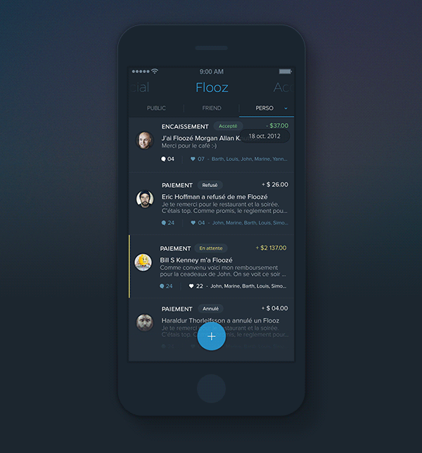
Mobile Apps, Designing for mobile?
Mobile web interfaces take a different sort of design practice, whether they are for mobile websites or native mobile applications. With a different sort of device, and a more noticeably different screen size, we as designers must consider a new set of best practices for design.
Notes:
A computer software application that is coded in a browser-supported language (such as JavaScript, combined with a browser-rendered markup language like HTML) to perform certain tasks based on user inputs and reliant on a common web browser (IE, Firefox, etc) to render the application executable

Slide 10
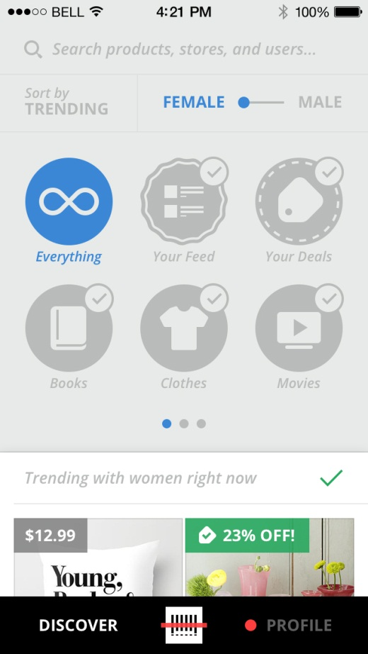
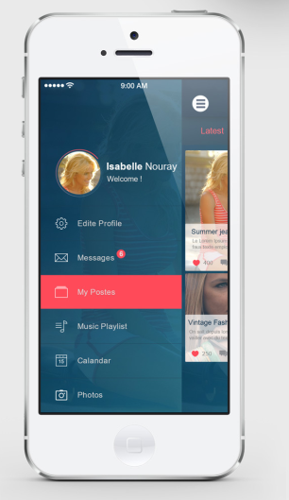
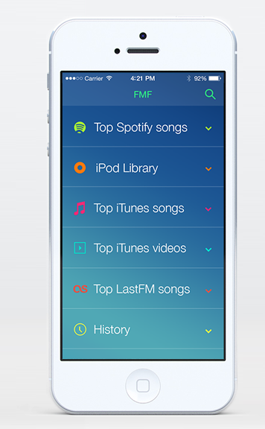
Mobile Apps, Designing for mobile?
1. Limited and Big Navigation
For mobile website versions, there are a few best practices for navigation to keep in mind:
Keep buttons large with extra padding and spacing. Many mobile devices are touch screen and bigger buttons mean easier clicking.
Keep navigation simple. Don't flood a navigation bar with several options; instead choose five or less, and create sub-navigation if necessary. This not only gives more room to make navigation larger for touch screens, but also simplifies navigating for those who may have other forms of input(like tiny arrows on a tiny keyboard!).
Vertical navigation is far more of a trend, and easier on many mobile input devices. If using any sort of horizontal navigation, keep it extra minimal.
User the "button style" design over standard text links for the navigation.
2. Helpful Icons
One major trend for mobile design that can also be considered a great design practice is the use of icons. This is especially helpful for primary navigation, but icons can also be of great use for other types of links, or even as just visual helpers.
Notes:
A computer software application that is coded in a browser-supported language (such as JavaScript, combined with a browser-rendered markup language like HTML) to perform certain tasks based on user inputs and reliant on a common web browser (IE, Firefox, etc) to render the application executable

Slide 11
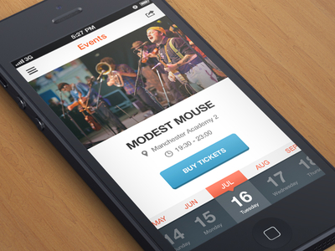
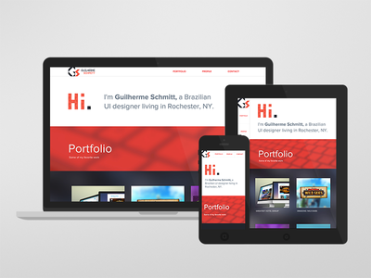
Mobile Apps, Designing for mobile?
3. Limited Images Within Content
For incredibly small screens, some images should be cut out entirely. Anything that would drastically increase vertical scrolling can be an issue, and even more so for slower mobile devices where simply downloading excess images is enough of a problem. For mobile design, keep the use of images small, and only use when needed.
4. Responsive Design
When it comes to mobile design, responsive web design often comes to mind. Have a layout that is fully flexible while implementing other practices that help out mobile users or otherwise, such as saving on bandwidth and file sizes for lesser devices, changing image sizes, and having alternatives for certain features(like video) that may not be supported by all devices.
Notes:
A computer software application that is coded in a browser-supported language (such as JavaScript, combined with a browser-rendered markup language like HTML) to perform certain tasks based on user inputs and reliant on a common web browser (IE, Firefox, etc) to render the application executable

Slide 12
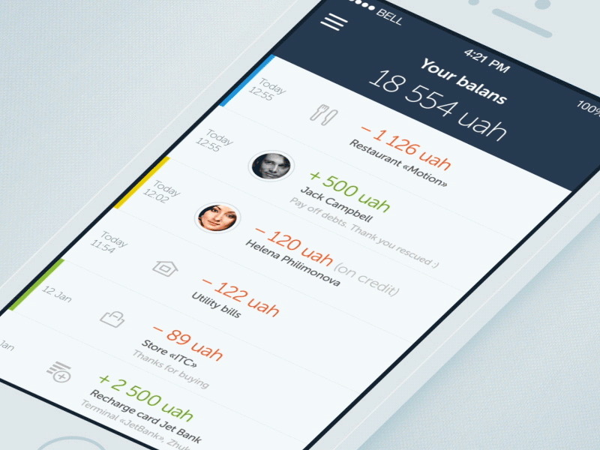

Mobile Apps, Designing for mobile?
5. Shorter Elements (Vertical Space)
A smaller screen means saving space in a practical way. Since horizontal scrolling is not even possible on many mobile browsers, let alone not user friendly in the slightest for everything else that does support it, you should create flexible designs that prevent horizontal scrolling at all costs. With horizontal scrolling out of the question, our main way of viewing content now turns to vertical scrolling.
6. Don't Be Afraid of Whitespace
Just like with design on a standard size screen, whitespace is needed in mobile design as well. In fact, it might be needed more as screen sizes get smaller and navigation may get harder to deal with. Without whitespace, on a smaller screen content could be more difficult to read, and anything smooshed together isn't a good idea!
Notes:
A computer software application that is coded in a browser-supported language (such as JavaScript, combined with a browser-rendered markup language like HTML) to perform certain tasks based on user inputs and reliant on a common web browser (IE, Firefox, etc) to render the application executable

Slide 13
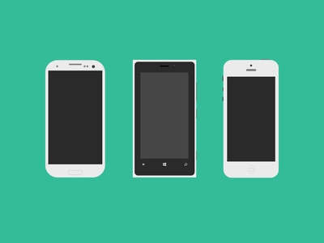
Mobile Apps, Designing for mobile?
Conclusion
While many of our basic design principles may remain the same, when it comes to designing for smaller devices, and possibly less capable devices as well, we must consider a whole new set of best design practices. The interface of a mobile website design should be drastically different than that of a standard size design, and it can take a whole new learning curve to learn what works best for smaller screens.
What additional tips to you have for creating mobile interfaces? What are some differences, and are there any design practices that should remain the same no matter what device?
Notes:
A computer software application that is coded in a browser-supported language (such as JavaScript, combined with a browser-rendered markup language like HTML) to perform certain tasks based on user inputs and reliant on a common web browser (IE, Firefox, etc) to render the application executable

Slide 14
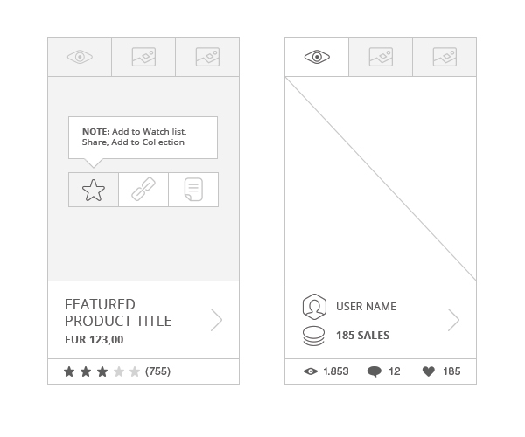
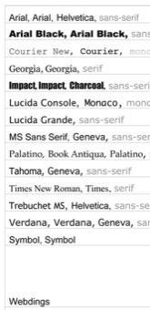
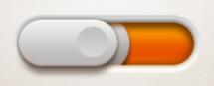
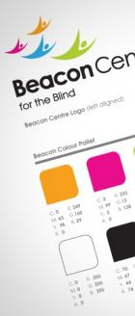
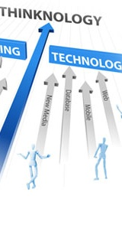
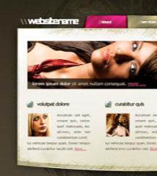

Understanding the Key Elements
Elements associated with web design
Wireframes
Font / Typeface
Vector & Raster graphics
Brand Guidelines
Color Dependencies
Technology Constraints
Timeline
Notes:
These are not Challenges. By Design Challenge we mean understanding the business requirement in a proper way so that we can offer/deliver the best solution to address that. The heading can be “Understanding the UI Elements”. Tech Constraint can be under a separate section under “Dependencies”.

Slide 15
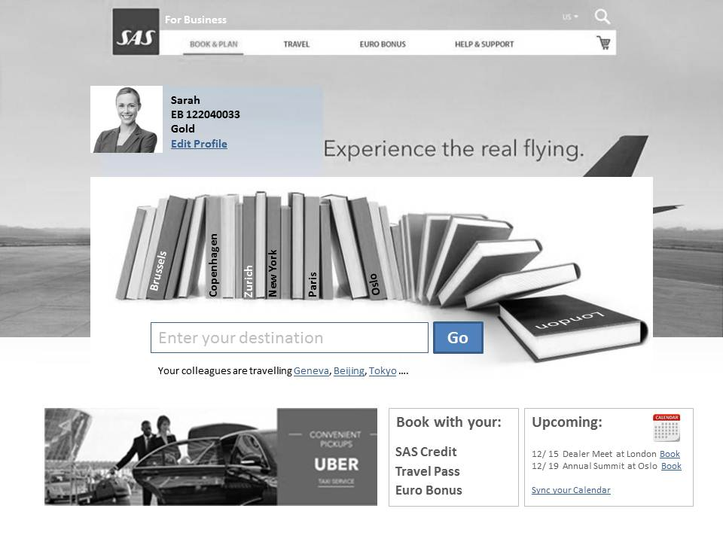
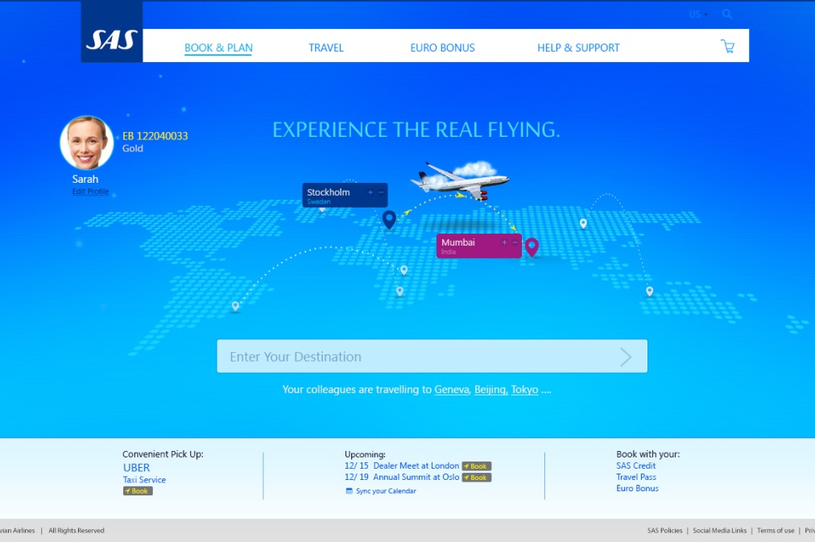
Understanding the Key Elements
Understanding the Wireframe
A website wireframe, also known as a page schematic or screen blueprint, is a visual guide that represents the skeletal framework of a website. The wireframe depicts the page layout or arrangement of the website’s content, including interface elements and navigational systems, and how they work together. The wireframe usually lacks typographic style, color, or graphics, since the main focus lies in functionality, behaviour, and priority of content. In other words, it focuses on “what a screen does, not what it looks like. Wireframes can be pencil drawings or sketches on a whiteboard, or they can be produced by means of a broad array of free or commercial software applications.

Slide 16
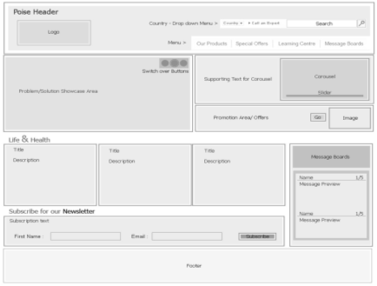
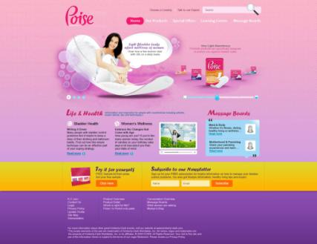
Understanding the Key Elements
Understanding the Wireframe
Wireframes focus on
The kind of information displayed
The range of functions available
The relative priorities of the information and functions
The rules for displaying certain kinds of information
The effect of different scenarios on the display

Slide 17
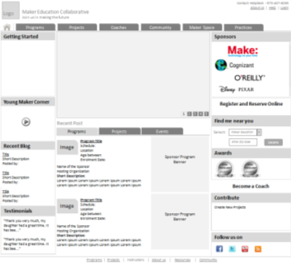
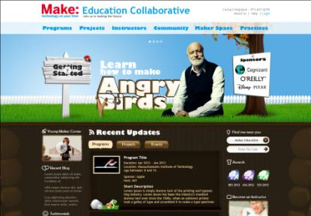
Understanding the Key Elements
One of the designs
Understanding Wireframes
The website wireframe connects the underlying conceptual structure, or information architecture, to the surface, or visual design of the website. Wireframes help establish functionality, and the relationships between different screen templates of a website. An iterative process, creating wireframes is an effective way to make rapid prototypes of pages, while measuring the practicality of a design concept. Wireframing typically begins between “high-level structural work—like flowcharts or site maps—and screen designs. Within the process of building a website, wireframing is where thinking becomes tangible

Slide 18
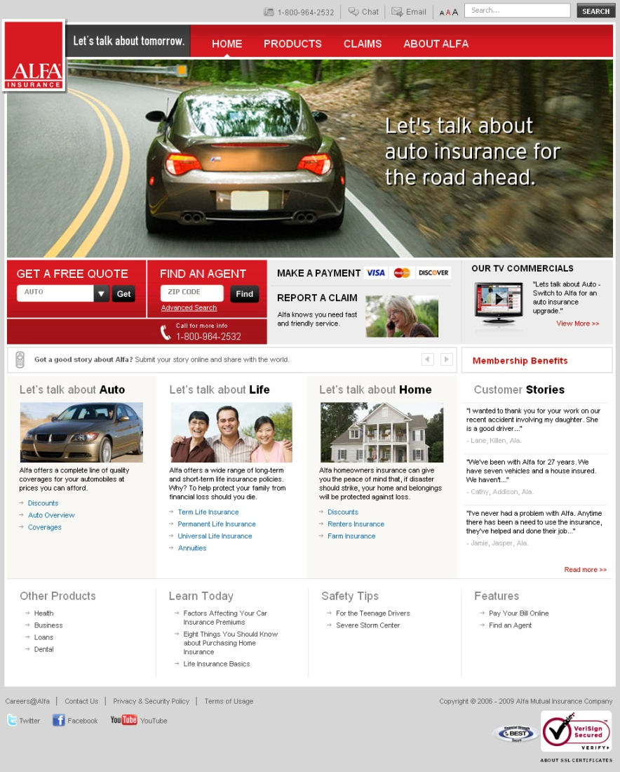
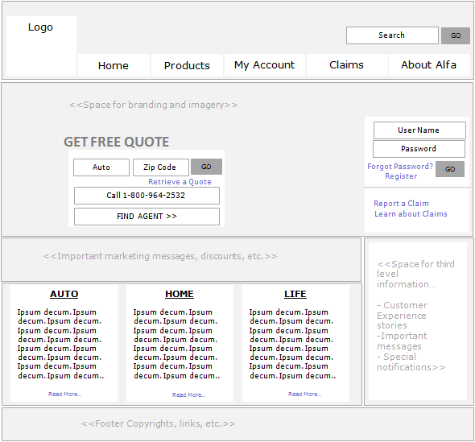
Some Live examples
One of the designs
https://www.alfains.com/AlfaInsPortalWebApp/Home.jsp

Slide 19
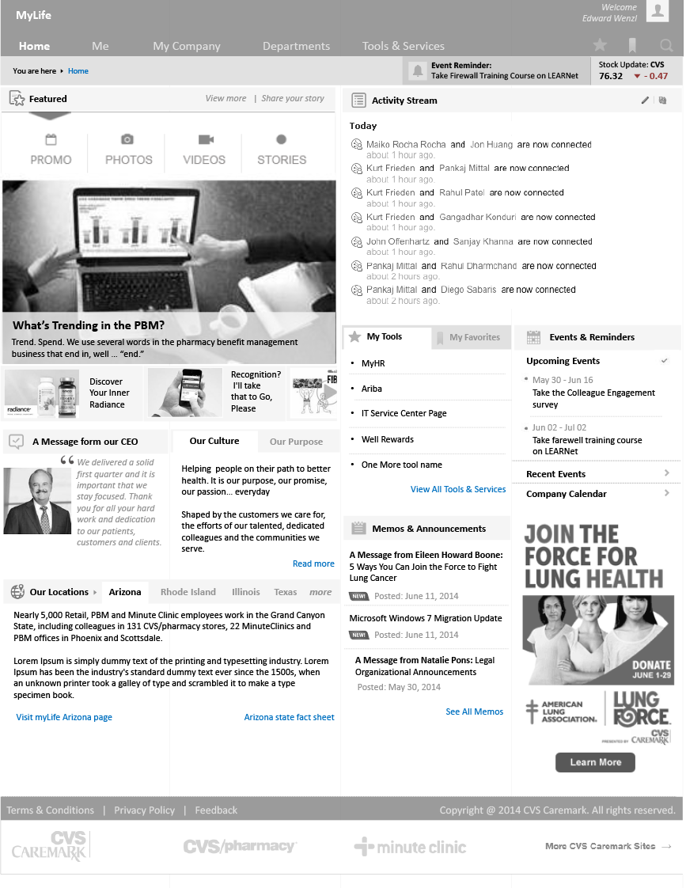
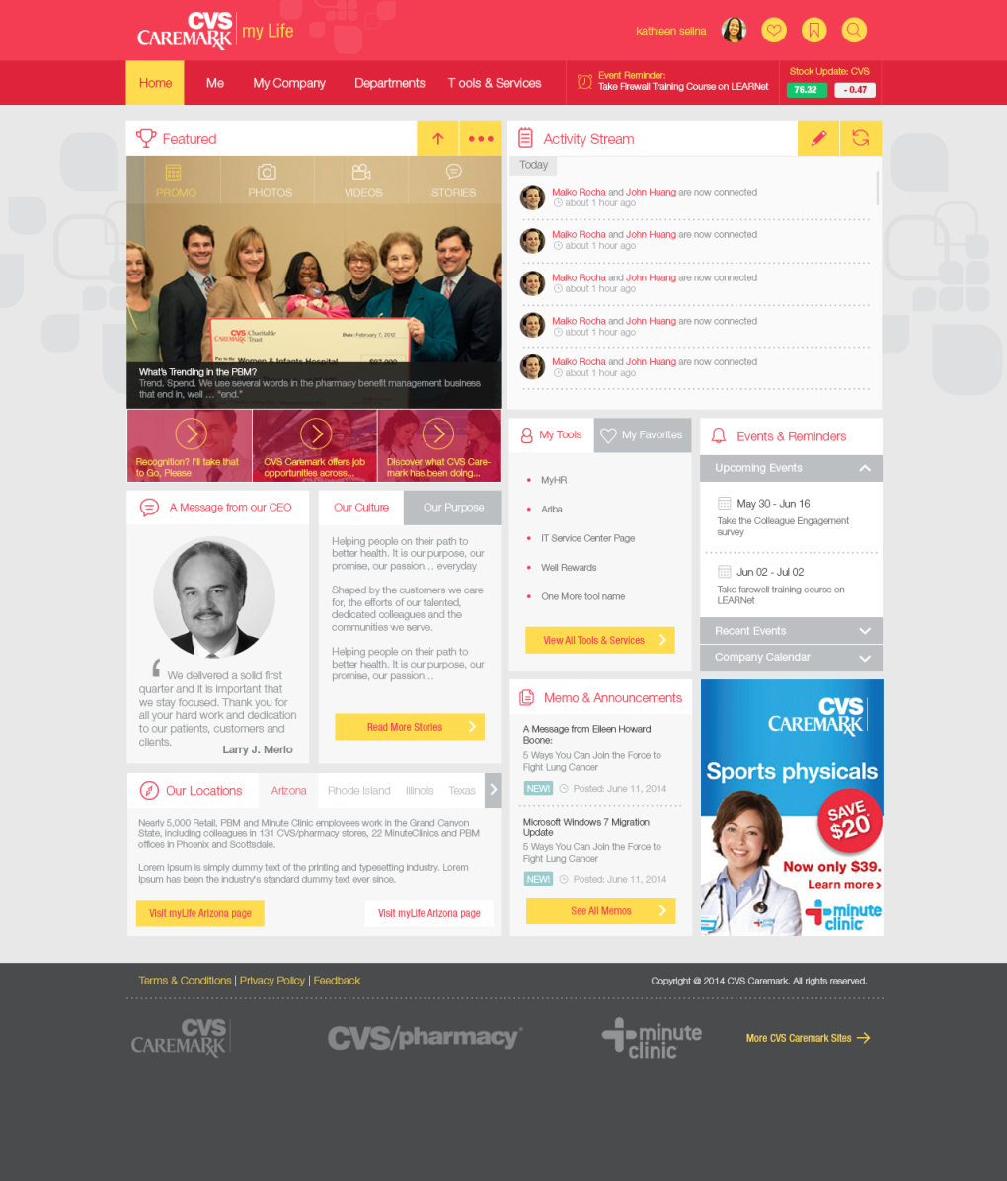
Some Live examples
One of the designs

Slide 20
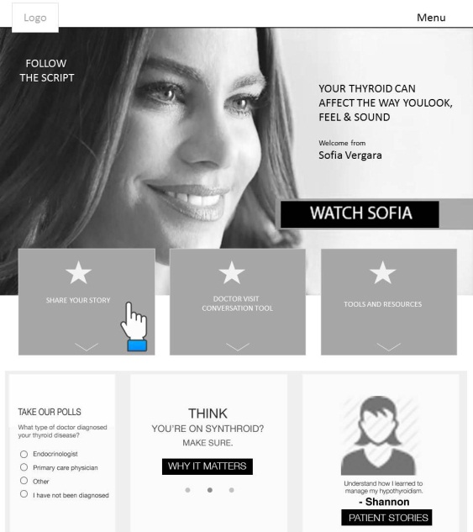
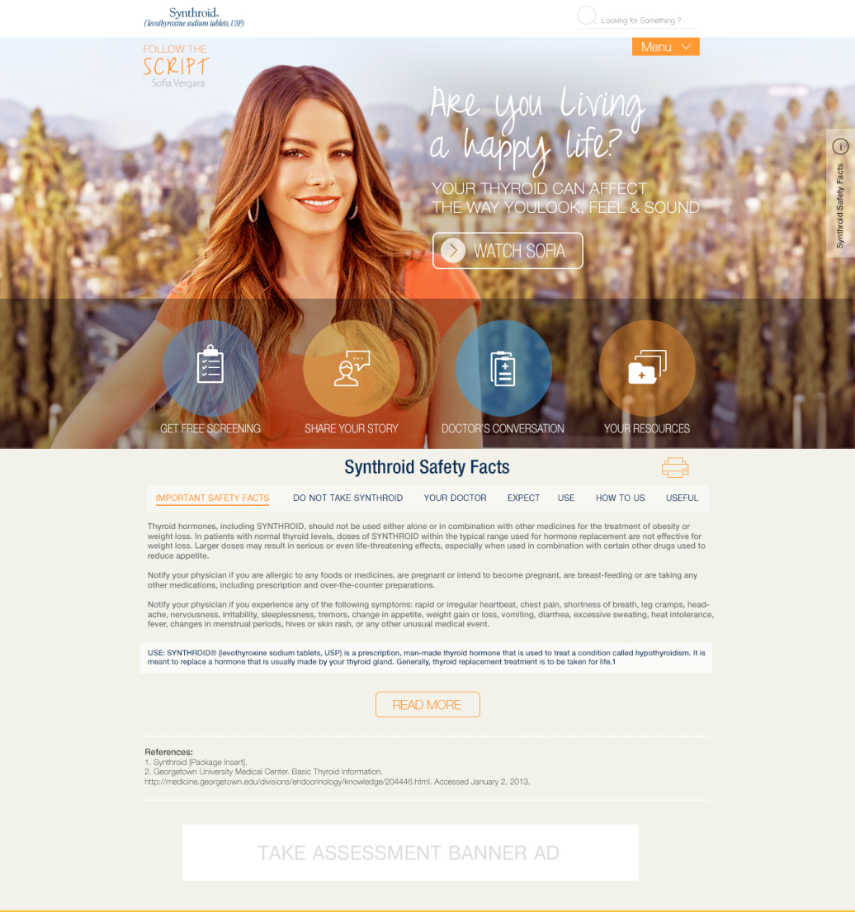
One of the designs

Slide 21
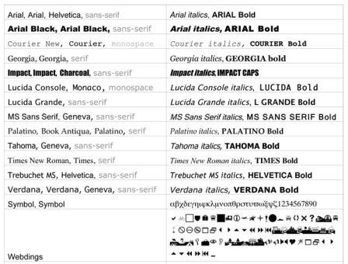
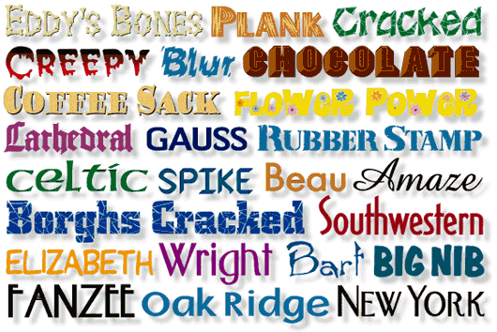
Understanding the Key Elements
Font Usage
Web Safe fonts : The fonts listed in the image on the left are web safe fonts. For all the dynamic or paragraph textual contents, these fonts alone should be used.
Special font faces : For all other sections of the sites like banner text, section headings, page headings etc, any special font can be used and should be embedded as images.
Fonts for Flash : For all Flash content, any typeface can be used and we can embed them easily so it will look the same in all the platforms.
Fonts for Accessibility : When designing for Accessibility, font size play a major role.

Slide 22

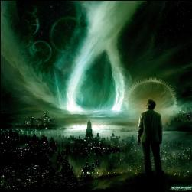
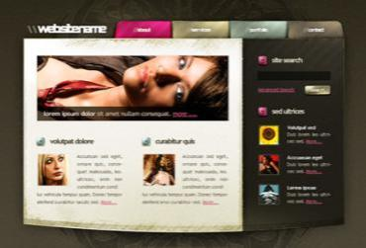
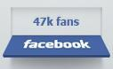
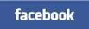

Understanding the Key Elements
Vector vs. Raster
When to use Vector? While developing graphic which requires scaling. Usually this boils down to business identity print work, logos, promotional posters, and major illustration artwork. When you want clean-cut and clearly defined shapes - vector is the only way to go.
When to use Raster? Any image generated in jpeg, png, tiff etc. commonly used format are raster graphic. We use raster in photographs and images done in a raster program. We use it when we put an effect on image, or editing and manipulating them. It’s when we’re adding a defined texture and accent on our created designs. If you want textures, fills and other effects, you use raster.

Slide 23
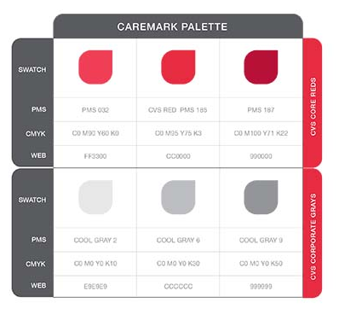
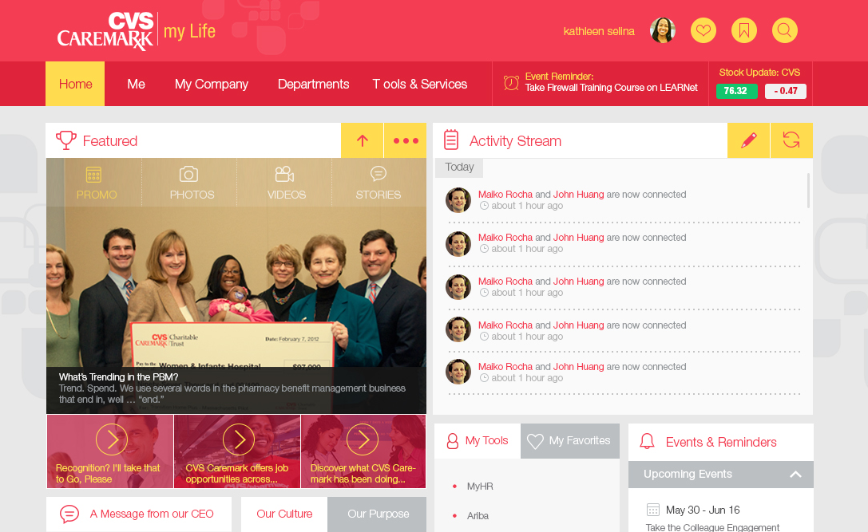
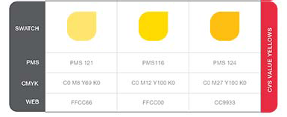
Understanding the Key Elements
Following brand guidelines
A brand guideline is a collection of typefaces, colors, rules and tips for the application of your logo and supporting visual style. In each brand guide, or “brand book,” there will traditionally be a section focused entirely on the logo itself: ways it should and should not be displayed, abbreviated and long versions of your logo and restrictions regarding the space surrounding it. A good brand guide will have a list of typefaces available to use and where each would be appropriate. The same goes for colors and any extra artwork you may have: stock photography, illustrations or icons. How each of these elements are applied is key to the visual style of your brand. If followed accurately, that is what a brand guide preserves.

Slide 24
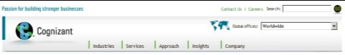
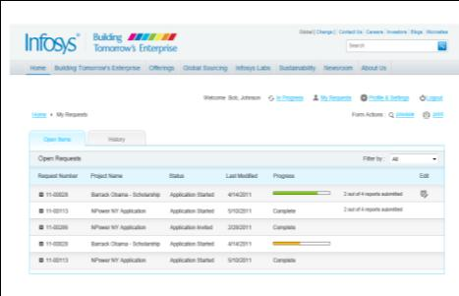
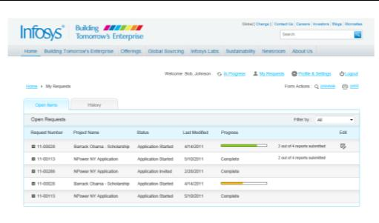
Understanding the Key Elements
Following brand guidelines
They help to form the basis for designs and the need for them as a means for a consistent way to represent a brand and instil a shared vision. When the user sees across the same brand theme across media and platform, the brand memory increases and so does the brand value of the company.
The above design is an example where the application should look good under different brand banners, still maintaining the visual appeal

Slide 25
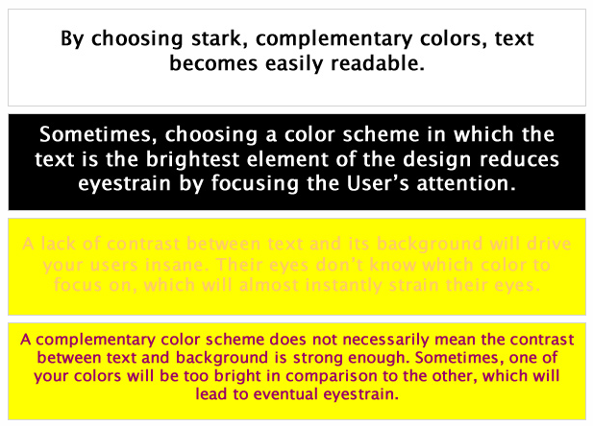
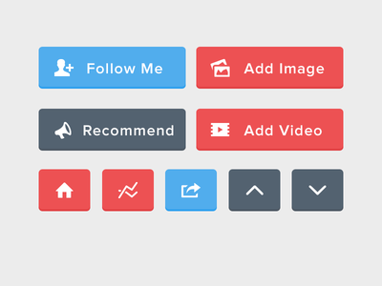
Understanding the Key Elements
Color Concept & Dependencies
Color is vital to content. If you consider a website important enough to spend time refining, then readers will likely consider it important enough to spend time reading. Good color choices make that happen. Sometimes removing color is a solution in itself. While designing, color ethics should always be considered as it has a deep impact on religion, sector, accessibility, user type etc.

Slide 26
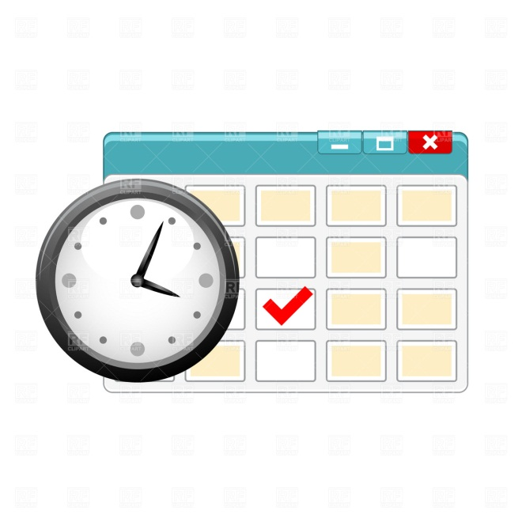

Understanding the Key Elements
Timeline
Being creative for a task is as important as meeting the deadline for it. Remember: “Nobody wants a sweater in summer”. While working on the timeline, the most vital thing is to give a proper estimation & consider these dependencies:
Estimating the Task
Estimating Effort Required to complete the task
Buffer Time
Feedback Dependencies
Assumptions
“The Devil is in the detail: When people say that the devil is in the detail, they mean that small things in plans and schemes that are often overlooked can cause serious problems later on.”

Slide 27
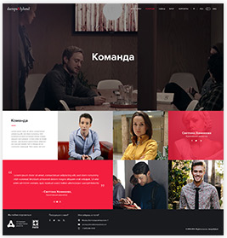
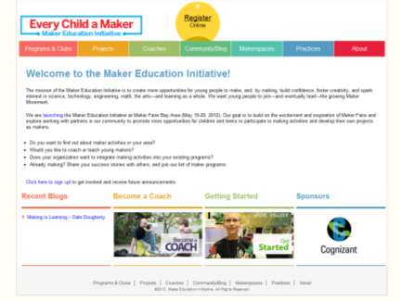
Understanding the Key Elements
Template Driven Technology
Many open source technologies are used nowadays which offer a faster solution. They are mostly used for places where a quick Blog, or e-commerce etc. is required. They offer basis visual templates and elements which can be customised according to client requirement. For e.g. WordPress is a free and open source blogging tool and a dynamic content management system (CMS) based on PHP and MySQL. It has many features including a plug-in architecture and a template system. Os-Commerce is used where a quick shopping cart is required.

Slide 28
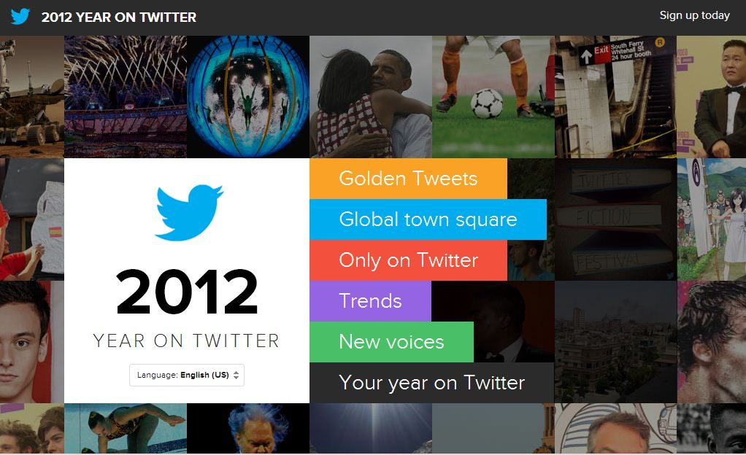

Web Design Trends and accessibility (https://www.apple.com/iphone-5c/)
Flat Design
A website with flat design lacks gradients, skeuomorphism, but incorporates solid colors, white space, and crisp typography. Windows 8 displays a completely crisp and flat design, but they aren't alone...lot of other corporates are all utilizing flat design.
Parallax
The Parallax web design trend has grown in popularity because it creates an illusion of depth (or a faux-3D effect) as you scroll through the webpage. Various images on the site will move at different speeds or change in size or at dimension to the site.
Complete flat : http://www.liber.io/
Image + flat: http://www.dejanulcej.com/
Video + flat: http://www.lobagola.com/ http://enjoy-aiia.com/#!/product/moderntronic
http://www.madwell.com/
http://www.intacto10years.com/index_start.php
http://discover.store.sony.com/be-moved/#xperia

Slide 29


Web Design Trends
Full-Screen Photo Launch Pages
If you want to convey a powerful message on your site, utilize a full-screen photo launch page. Your viewers will be immediately transported into another world of your creation. Sites have full-screen photo landing pages, not only to provide their users with an emotional experience, but also to convey the main message of their product.
Responsive Web Design (RWD) With the influx of new and innovative mobile devices, we are also seeing the rise of responsive web designs. RWD allows users to better read and experience the web from their laptop or desktop, as well as, tablet and cell phone. Responsive web templates are designed to look great on a variety of different screen sizes, so anyone can view your site in a crisp and clear manner where ever they go.
http://www.lozzaocchiali.it/sartoriale/#/it/tecnologia
http://enjoy-aiia.com/#!/product/moderntronic
http://forefathersgroup.com/
http://spigotdesign.com/

Slide 30
PAGE
COMPONENTS
Understanding Navigation Pattern & Style Design Defining Page Grids & Column layout
Using Best Screen Resolutions
Using Digital Assets

Slide 31





Navigation Patterns & Style
Page Components
1
2
4
5
3
6
1. Horizontal Navigation
2. Bread Crumb
3. Tab Navigation
4. Vertical Navigation
5. Fly out Menu
6. Footer Navigation

Slide 32


Grids and Column Layouts
Page Components
Why Follow Grids?
The idea is certainly not something that originated on the Web. In fact, it stems from one of the oldest and most basic design principles: alignment. Our brains like to simplify things to make them readily understandable. This is why we try to impose order on things that seem chaotic, like seeing a face in the craters on the moon.
Naturally, the easier it is to impose order, the quicker our brains can identify a pattern and move on. Grids are so organized and orderly that they require almost no interpretation our part.

Slide 33


Using Best Screen Resolutions
Page Components
Screen Resolutions
We are always reaching millions of users, with our designs. We are certainly uncertain about the screen resolutions of each user and it is always better to look at techniques to support maximum number of resolutions possible.
Be it gracefully presenting the content in a 800 x 600 px or giving that full on experience in a 1920 x 1080 px resolution., Howe ever, our industry standard has always been 1024 X 768 just because we design for the optimal web experience.
As nowadays different handheld device has come into play, the resolution and size needs to be referred before starting any design. Also now that responsive web design is in fashion, a lot of time people prefers to see responsive layout.

Slide 34

Using Best Screen Resolutions
Page Components
Tips and Tricks
Designing sites with a wider background graphic
All over the world more than 80% of the screen is 1280px or greater in width and 768px or greater in height. In US it’s 85% with the same dimension.
Again, As nowadays different handheld device has come into play, the resolution and size needs to be referred before starting any design. Also now that responsive web design is in fashion, a lot of time people prefers to see responsive layout.

Slide 35


Using Best Screen Resolutions
Page Components
Examples of Fluid Layouts
Tips and Tricks
Fluid/Liquid Layouts
All containers on the page have their widths defined in percents – meaning that they are completely based on the viewport rather than the initial containing block. A liquid layout will move in and out when you resize your browser window

Slide 36



Using Best Screen Resolutions : Global trends
Page Components
Global
US

Slide 37







Using Digital Assets
Things to remember before starting a design:
All the photographic images used in a design should be purchased by the client.
If the project is a Cognizant Corporate Initiative, the imagery should be purchased through Corp.Comm.Team
All the icons/illustrations should be created in Photoshop/Illustrator, no copy paste should happen from any site unless purchased.
Any special fonts used in a design should also be purchased/provided by the clients.
Any audio file used in any motion graphics or flash demo or any video should be licensed by the respective client.
Any video file that has copyrighted or stock clips should be licensed. Do not remove watermark from images till it is purchased by the client.
All the stock / royalty free assets come with a minimum restriction of giving credit to the artist in some part of the design. Always read through the T&C and act accordingly. Any discrepancy will lead up to Job Termination.

Slide 38
TECHNOLOGICAL
DEPENDENCIES
Knowing the technical scope w.r.t. Interactivity Understanding web technologies like JavaScript and JQuery
Concept of RIA
Understanding Browser types and their behaviour
Concept of SEO

Slide 39







Leveraging Technology and Designing with Dependencies
Technological Dependencies
Technology
Technology gives life to our design, some platforms gives more flexibility and freedom to think and some don’t.
Understanding the strengths and limitations of the technology is key to a successful design.
Connected Cities
Taking Computers Out of Computing
Quantified Selves
The Reductive Social Network: Technology Finally Gets Personal
Convergence Causing Specialization
Interaction Choreography
Reputation Enhanced Lending and Trading Becomes Mainstream
Base of the Pyramid Mobile Innovation
Digital Discovery in the Physical World
Flourishing Commerce in the Post-PC Era
The Age of the Algorithm
Biomimicry
Reign in the Clouds!
Remote Collaboration
Re-Shape: Humans Are Analogue
facts

Slide 40


Leveraging Technology and Designing with Dependencies
Technological Dependencies
Wordpress
WordPress is a free and open source blogging tool and a dynamic content management system (CMS) based on PHP and MySQL.
It has many features including a plug-in architecture and a template system.
WordPress itself doesn’t touch the design aspect of the site.
A WordPress site essentially comprises 2 parts:
The backend – which is the WordPress core code and delivers the CMS functionality
The front end – which is delivered by whatever theme you’re using and delivers the look and layout.
So what’s the best way to achieve a unique look and feel?
Either by building your own theme, or customising a premium theme, or a framework. This is the best way to achieve the look and feel you want, including having individual pages looking different.

Slide 41


Leveraging Technology and Designing with Dependencies
Technological Dependencies
SharePoint
SharePoint driven sites are very structured and have certain limits in aligning content and overlapping graphics.
Still we can fake it to an extent with a large bg image that can fit and degrade gracefully in different browser resolutions.
If we are targeting a closed audience like if we are making a intranet, we can leverage the power of Silverlight. Silverlight is a browser plugin like flash and can create rich interactions.

Slide 42


Leveraging Technology and Designing with Dependencies
Technological Dependencies
Flex
Flex has a unique method of designing. But the basic principles stay the same for any UI design.
Flex UI’s are mostly applications related to RIA. They are Dynamic and change as per user selections and loaded data.
Most designs are widget or component based. These are called pods or other flex UI components.
Flex UI’s can be designed with Flash, Fireworks or Photoshop.
Vector formats are most preferred as the UI’s interactions are often scaling in size and are flexible to user interactions.
Skinning is a delivery process of visual design for flex in individual component styling later composed to a desired UI mockup by the developer. This mockup should match your initial design.

Slide 43

Leveraging Technology and Designing with Dependencies
Technological Dependencies
HTML5
The possibilities of HTML5 cant be explained in a single slide. The above 2 sites pushes HTML5 capabilities to the maximum. Click on them to explore. Technically speaking almost anything is possible given the right browser, timeline and skill set of the developer. But making it big is in your hands, the designer
Below are few links that showcases what’s possible with HTML5.
https://www.themusicbed.com/

Slide 44


Leveraging Technology and Designing with Dependencies
Technological Dependencies
Jquery
Jquery and Jquery UI is often used along with other technologies. Few web applications use it as a core technology still relying on few other technologies for other bits and pieces of the application.
The above two examples portray a page flip and a before and after slider using jquery. Other than these complex effects we can have simple transitions, banner sliders, etc. The below links can give a fair understanding on possibilities with jquery.
http://www.jquerymagic.com/
http://jqueryui.com/demos/

Slide 45

Leveraging Technology and Designing with Dependencies
Technological Dependencies
Understanding browser types and their behavior
There are numerous browsers used by people for surfing the internet. Some of the commonly used browsers are Internet Explorer, Mozilla Firefox, Google Chrome, Safari, Opera, Netscape, and so on. Now, if you observe carefully, you will find that some websites look quite different in different web browsers
Each browser parses a web code in a different way. A good web design aims to give a uniform look to the website, viewed from
any web browser.
A good website should be viewable in its full functionality on any web browser. This is called cross-browser compatibility.

Slide 46

Leveraging Technology and Designing with Dependencies
Technological Dependencies
Concept of SEO
Each search engine has its own algorithm in ranking web pages. Understanding the general factors that influence the algorithm can affect your search result position, and this is what SEO experts are hired for. SEO isn't only for online marketers. As a web designer or frontend developer, most on-site SEO is your responsibility.
Top 9 SEO Mistakes Made by Designers and Developers
Splash Page
Non crawlable Flash Menus
Image and Flash Content
Overuse of Ajax
Versioning of Theme Design
“Click Here” Link Anchor Text
Common Title Tag Mistakes
Empty Image Alt Attribute
Unfriendly URLs

Slide 47
OPTIMIZING THE
DELIVERABLE
Image optimization & slicing best practices
Arrangement of layers & grouping in Photoshop
Proper nomenclature of files and folders

Slide 48



Image optimization & slicing best practices
Optimizing the Deliverables
Image Optimization
Image optimization is one of the key elements in web design, as it plays a major role in site loading time.
Individual Slices and Sprites
Individual slices are good to start with, lately sprites are widely used. A sprite is a collection of slices, tightly packed in one single image. In the above iStock example, there are about 50 slices packed in one image, which reduces the number of http requests from 50 to 1. This is a huge optimization compared to tradition individual slices. Always use “Save for Web” option, it optimizes the file size to a large extent while maintaining the quality of the image.

Slide 49


Image optimization & slicing best practices
Optimizing the Deliverables
gif vs. png
The two types of transparent images that were always debated against each other. “gif” images have wider compatibility with older browsers, where png offers great flexibility, rich visual appearance and easy to implement/execute. One challenge when using “gif” images is to keep the bg area of the slice in similar hue, else the html will start to show artifacts.

Slide 50


Arrangement of layers & grouping in Photoshop
Optimizing the Deliverables
Project Name
Folder Structure/Layers
The image in the left shows the folder structure followed by CI. Following folder structure is a must in all the projects as it will help and save a lot of time in getting the files for someone who may take over the project in a latter point of time.
The same applies for layer structuring.
File Naming
Below is the file naming structure
Option01PageNamev1
Option01PageNamev2
Option01PageNamev3
Option02PageNamev1
Option02PageNamev2
Option02PageNamev3
Option01PageNamev4
Option03PageNamev1
Option03PageNamev2
Output
jpeg
slices
PSD
options
final
Resources
wireframes
reference
Brand docs

Slide 51
Let’s Begin!

